Slide 1
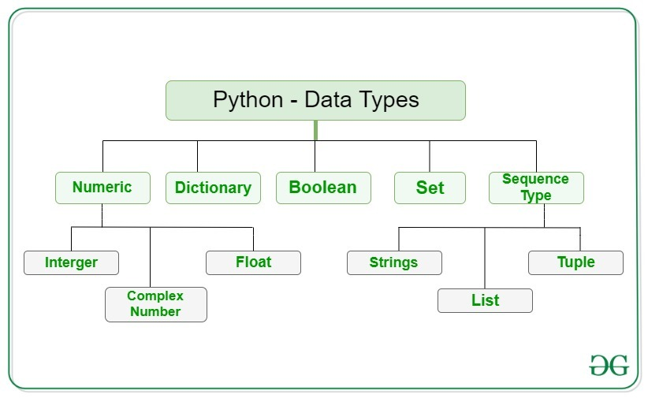
Python Data Types

Slide 2
Booleans
Boolean in Python can have two values – True or False
Constants values and can be used to assign or compare boolean values
condition = True
If condition: is equivalent to if condition == True :

Slide 3
Numbers
The numbers in Python are classified using the following keywords.
int, float, and complex.
Python has a built-in function type() to determine the data type of a variable or the value.
Another built-in function isinstance() is there for testing the type of an object.
Integers in Python don’t have any size limitation as long as the required memory is available.
A float type number can have precision up to 15 decimal places.

Slide 4
Strings
A sequence of one or more characters enclosed within either single quotes ‘ or double quotes ” is considered as String
Strings are immutable. It means the memory will be allocated once and re-used thereafter.
Python allows slicing strings using a special square-bracket syntax to extract a substring.
Ordered sequence of characters
Example:-
mystring = ‘Python3’

Slide 5
Bytes
Bytes are Immutable
It can store a sequence of bytes (each 8-bits) ranging from 0 to 255.
Byte objects contain a sequence of bytes whereas the strings store sequence of characters.
The bytes are machine-readable objects whereas the strings are just in human-readable form.
Since the byte is machine-readable, so they can be directly stored to the disk. Whereas the strings first need to encoded before getting on to the disk.
Example:
emptyobject = bytes(16)

Slide 6
Lists
Can store different data types
Duplicate values are allowed
Order is retained
Indexing and slicing is possible
Mutable
A list can contain another list. Such a list is called as the nested list.
Python allows modifying a list or its elements via assignments as well as through the built-in list methods.
Example:-
mylist = [1,2,3,4,5]

Slide 7
Tuples
Can store different data types
Duplicate values are allowed
Order is retained
Indexing and slicing is possible
Immutable.
Repetition in tuples
Sample_tuple = (‘Python’,)*3
Python does not allow to modify a tuple after it is created. We can not add or remove any element later
Python uses tuples to return multiple values from a function.
Tuples are more lightweight than lists.
It works as a single container to stuff multiple things.
We can use them as a key in a dictionary.
Example:
mytuple = (‘Python’,)

Slide 8
Sets
Can store different data types
Duplicate values are not allowed
Order is not retained
Indexing and slicing is not possible
Supports mathematical operations like union, intersection, symmetric difference etc.
Example
myset = {1,2,’a’,’b’}

Slide 9
Dictionary
Can store different data types
Order doesn’t matter here
Keys should be unique
Mutable
The dictionary solves the problem of efficiently storing a large data set. Python has made the dictionary object highly optimized for retrieving data.
syntax for creating dictionaries use braces {} where each item appears as a pair of keys and values.
Python exposes following built-in dictionary functions.
keys() – It isolates the keys from a dictionary.
values() – It isolates the values from a dictionary.
items() – It returns the items in a list style of (key, value) pairs.
Example
mydict = {‘key1’:’value1’, ‘key2’:’value2’}

